Slide 1
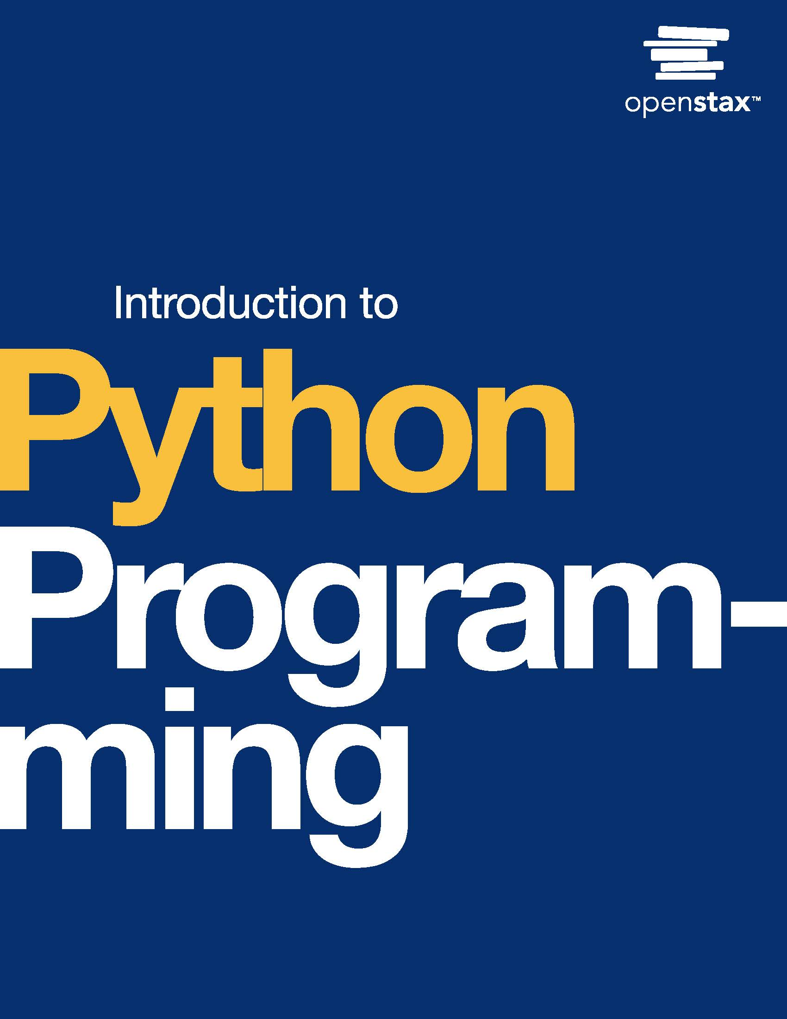
Introduction to Python Programming
Chapter 13: Inheritance

Slide 2
Chapter outline
Inheritance basics
Attribute access
Methods
Hierarchical inheritance
Multiple inheritance and mixin classes

Slide 3
13.1 Inheritance basics
Learning Objectives
Identify is-a and has-a relationships between classes.
Differentiate between a subclass and a superclass.
Create a superclass, subclass, and instances of each.

Slide 4
13.1 Inheritance basics
is-a vs has-a relationships
Classes are related to each other. An is-a relationship exists between a subclass and a superclass.
Ex: A daffodil is a plant. A Daffodil class inherits from a superclass, Plant.
Is-a relationships can be confused with has-a relationships.
A has-a relationship exists between a class that contains another class.
Ex: An employee has a company-issued laptop. Note: The laptop is not an employee.

Slide 5
13.1 Inheritance basics
Inheritance in Python
Inheritance uses an is-a relationship to inherit a class from a superclass. The subclass inherits all the superclass's attributes and methods, and extends the superclass's functionality.
In Python, a subclass is created by including the superclass name in parentheses at the top of the subclass's definition:
class SuperClass: # SuperClass attributes and methods
class SubClass(SuperClass): # SubClass attributes and methods

Slide 6
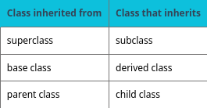
Table 13.1

Slide 7
13.2 Attribute access
Learning Objectives
Implement a subclass that accesses inherited attributes from the superclass.
Write a subclass's __init__() that inherits superclass instance attributes and creates new instance attributes.

Slide 8
13.2 Attribute access
Creating a simple subclass
Subclasses have access to the attributes inherited from the superclass. When the subclass's __init__() isn't explicitly defined, the superclass's __init__() method is called. Accessing both types of attributes uses the same syntax.

Slide 9
13.2 Attribute access
Using __init__() to create and inherit instance attributes
A programmer often wants a subclass to have new instance attributes as well as those inherited from the superclass.
Explicitly defining a subclass's __init__() involves defining instance attributes and assigning instance attributes inherited from the superclass.

Slide 10
13.3 Methods
Learning Objectives
Write overridden methods to change behavior of inherited methods.
Use super() to access superclass methods.
Identify applications of polymorphism in method and function use.

Slide 11
13.3 Methods
Overriding methods
Sometimes a programmer wants to change the functions a subclass inherits.
Mint is a subclass that has the same functionality as Plant, except for one function.
A subclass can override a superclass method by defining a method with the same name as the superclass method.

Slide 12
13.3 Methods
super()
super() is a special method that provides a temporary superclass object instance for a subclass to use.
super() is commonly used to call superclass methods from a subclass.
super() is commonly used in a subclass's __init__() to assign inherited instance attributes. Ex: super().__init__().

Slide 13
13.3 Methods
Polymorphism
Polymorphism is the concept of having many forms. In programming, a single name can be used for multiple functionalities.
Within inheritance, polymorphism is the basis of method overriding, as multiple methods have the same name.

Slide 14
13.4 Hierarchical inheritance
Learning Objectives
Label relationships between classes as types of inheritance.
Construct classes that form hierarchical inheritance.

Slide 15
13.4 Hierarchical inheritance
Hierarchical inheritance basics
Hierarchical inheritance is a type of inheritance in which multiple classes inherit from a single superclass.
Multilevel inheritance is a type of inheritance in which a subclass becomes the superclass for another class.
Combining hierarchical and multilevel inheritance creates a tree-like organization of classes.

Slide 16
13.4 Hierarchical inheritance
Implementing hierarchical inheritance
Multiple classes can inherit from a single class by simply including the superclass name in each subclass definition.

Slide 17
13.5 Multiple inheritance and mixin classes
Learning Objectives
Construct a class that inherits from multiple superclasses.
Identify the diamond problem within multiple inheritance.
Construct a mixin class to add functionality to a subclass.

Slide 18
13.5 Multiple inheritance and mixin classes
Multiple inheritance basics
Multiple inheritance is a type of inheritance in which one class inherits from multiple classes.
A class inherited from multiple classes has all superclasses listed in the class definition inheritance list
Ex: class SubClass(SuperClass_1, SuperClass_2).

Slide 19
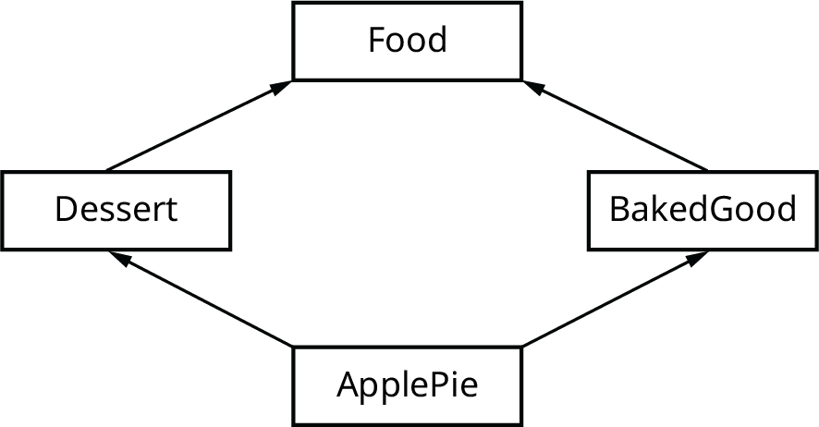
The Diamond Problem
The diamond problem occurs when a class inherits from multiple classes that share a common superclass.
Ex: Dessert and BakedGood both inherit from Food,
ApplePie inherits from Dessert and BakedGood.
The diamond problem. If both Dessert and BakedGood override a Food method, the overridden Food method that ApplePie inherits is ambiguous. Thus, diamond shaped inheritance should be avoided.
Notes:
The diamond problem. If both Dessert and BakedGood override a Food method, the overridden Food method that ApplePie inherits is ambiguous. Thus, diamond shaped inheritance should be avoided.

Slide 20
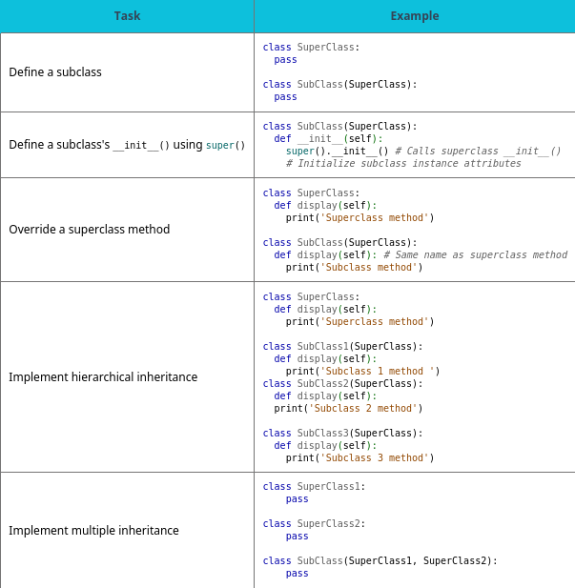
Chapter 13 reference.

Slide 21
This ancillary resource is licensed under a Creative Commons Attribution-NonCommercial-ShareAlike 4.0 (CC BY NC-SA) license; it may be distributed, remixed, built upon for noncommercial purposes only, and must be attributed to OpenStax and redistributed under the same license.

